Slide 1
Introduction to C#
.NET Programming
Please pick up a name tag and a training companion (if you opted in)
Electronic copies of the training companion can be found here:
U:\Public_Access\Training Companions\Epic 2015\All Training Companion PDFs\Foundations

Slide 2
Introduction
Meet your neighbors!
Share the following
Name
Team
Role
Why are you here?
OOP Experience

Slide 3
Introduction
What is your
Name?
Team?
Role?
What is your Object-Oriented Programming experience, if any?
Why are you here?

Slide 4
Schedule
Monday
All-Epic guest speaker 9:30 – 11 AM
Lecture: 1 PM to <= 5PM
Tuesday-Friday
Lecture: 8:30 AM to <= 12:00 PM
Lab: ~1:00 PM to 4:30 PM
This is roughly what the schedule will be. Depending on timing, lecture may continue after lunch for a bit.

Slide 5
Schedule
Tuesday-Friday
Lecture: 8:30 AM to ~ 3:00 PM
Lab: Afterwards
Schedule will vary slightly by day and topic

Slide 6
Schedule
Monday-Friday
Lecture: 8:30 AM to ~ Noon
10:30 AM today
Lab: Afterwards
Schedule will vary slightly by day and topic

Slide 7
Why C#?

Slide 8
Why C#?
VB6 is not officially supported by Microsoft anymore
Object oriented programming
Avoid "dll Hell"

Slide 9
Example Program
using System;
namespace Epic.Training
{
class HelloWorld
{
static void Main(string[] args)
{
Console.WriteLine("Hello World!");
Console.ReadLine();
}
}
}

Slide 10





VB Hyperspace
We are moving!
Current
Citrix Protocol
EpicComm
Thin Client
Citrix Server
Production
Server
Old!
Chronicles
VB 6
Caché
New!
Web protocol
Epic Communication Foundation (ECF)
Client
(Web)
Server
Database
(Server)
Chronicles
HTML/CSS
JavaScript
ASP.NET
C#
Caché

Slide 11
Hyperspace Web
New Architecture!
Web protocol
Epic Communication Foundation (ECF)
Client
(Web)
Server
Database
(Server)
Chronicles
HTML/CSS
JavaScript
ASP.NET
C#
Caché

Slide 12
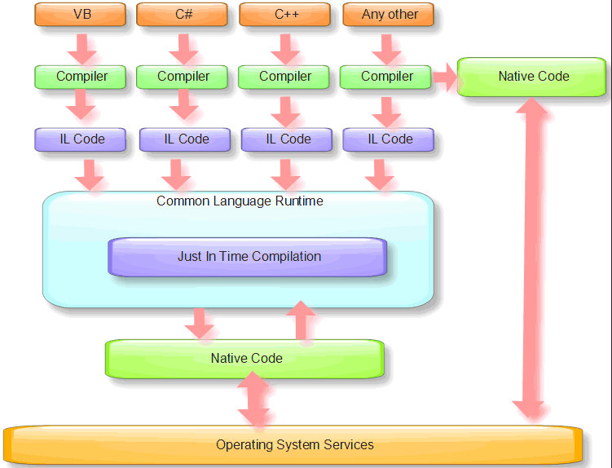
.NET Execution Model
Foundations .NET Wiki

Slide 13
About this class
Difficulty
C# Self-Study
Developers
Experienced OOP programmers
Understanding learners
C# Lecture (This Class)
Those who want to program in C# that want lecture
C# for TS
Those that want to support HSWeb/C# applications, but will not be programming in C#

Slide 14
Materials
Digital or paper training companion
U:\Public_Access\Training Companions\Epic 2015\All Training Companion PDFs\Foundations
Supported Visual Studio editions:
2013 Professional - or -
2013 Express Desktop
Visual studio 2015 is not officially approved for development (yet). It will be soon, but trainers and training materials have not been updated, so use it at your own risk.

Slide 15
Getting Help
General C# Questions
http://msdn.microsoft.com
Epic-specific message board for programming questions
http://nullex
Tech Camp Study Hall
http://brainbow.epic.com/Learning/Profile.aspx?id=18459

Slide 16
MSIL Code
Multiple languages implement the .NET framework
Need a common underbelly
Microsoft Intermediate Language
IL Disassembler

Slide 17
Common Language Runtime (CLR)
Assembly Manifest
Just-in-time compiling (JIT-er)
Global Assembly Cache (GAC)
Manages .NET assembly execution

Slide 18
Visual Studio
Comprehensive IDE
C# 2010/2012 Express is the minimum you'll need
Need professional if continuing to WTC
Moving to NET 4.5 very soon

